Slide 1
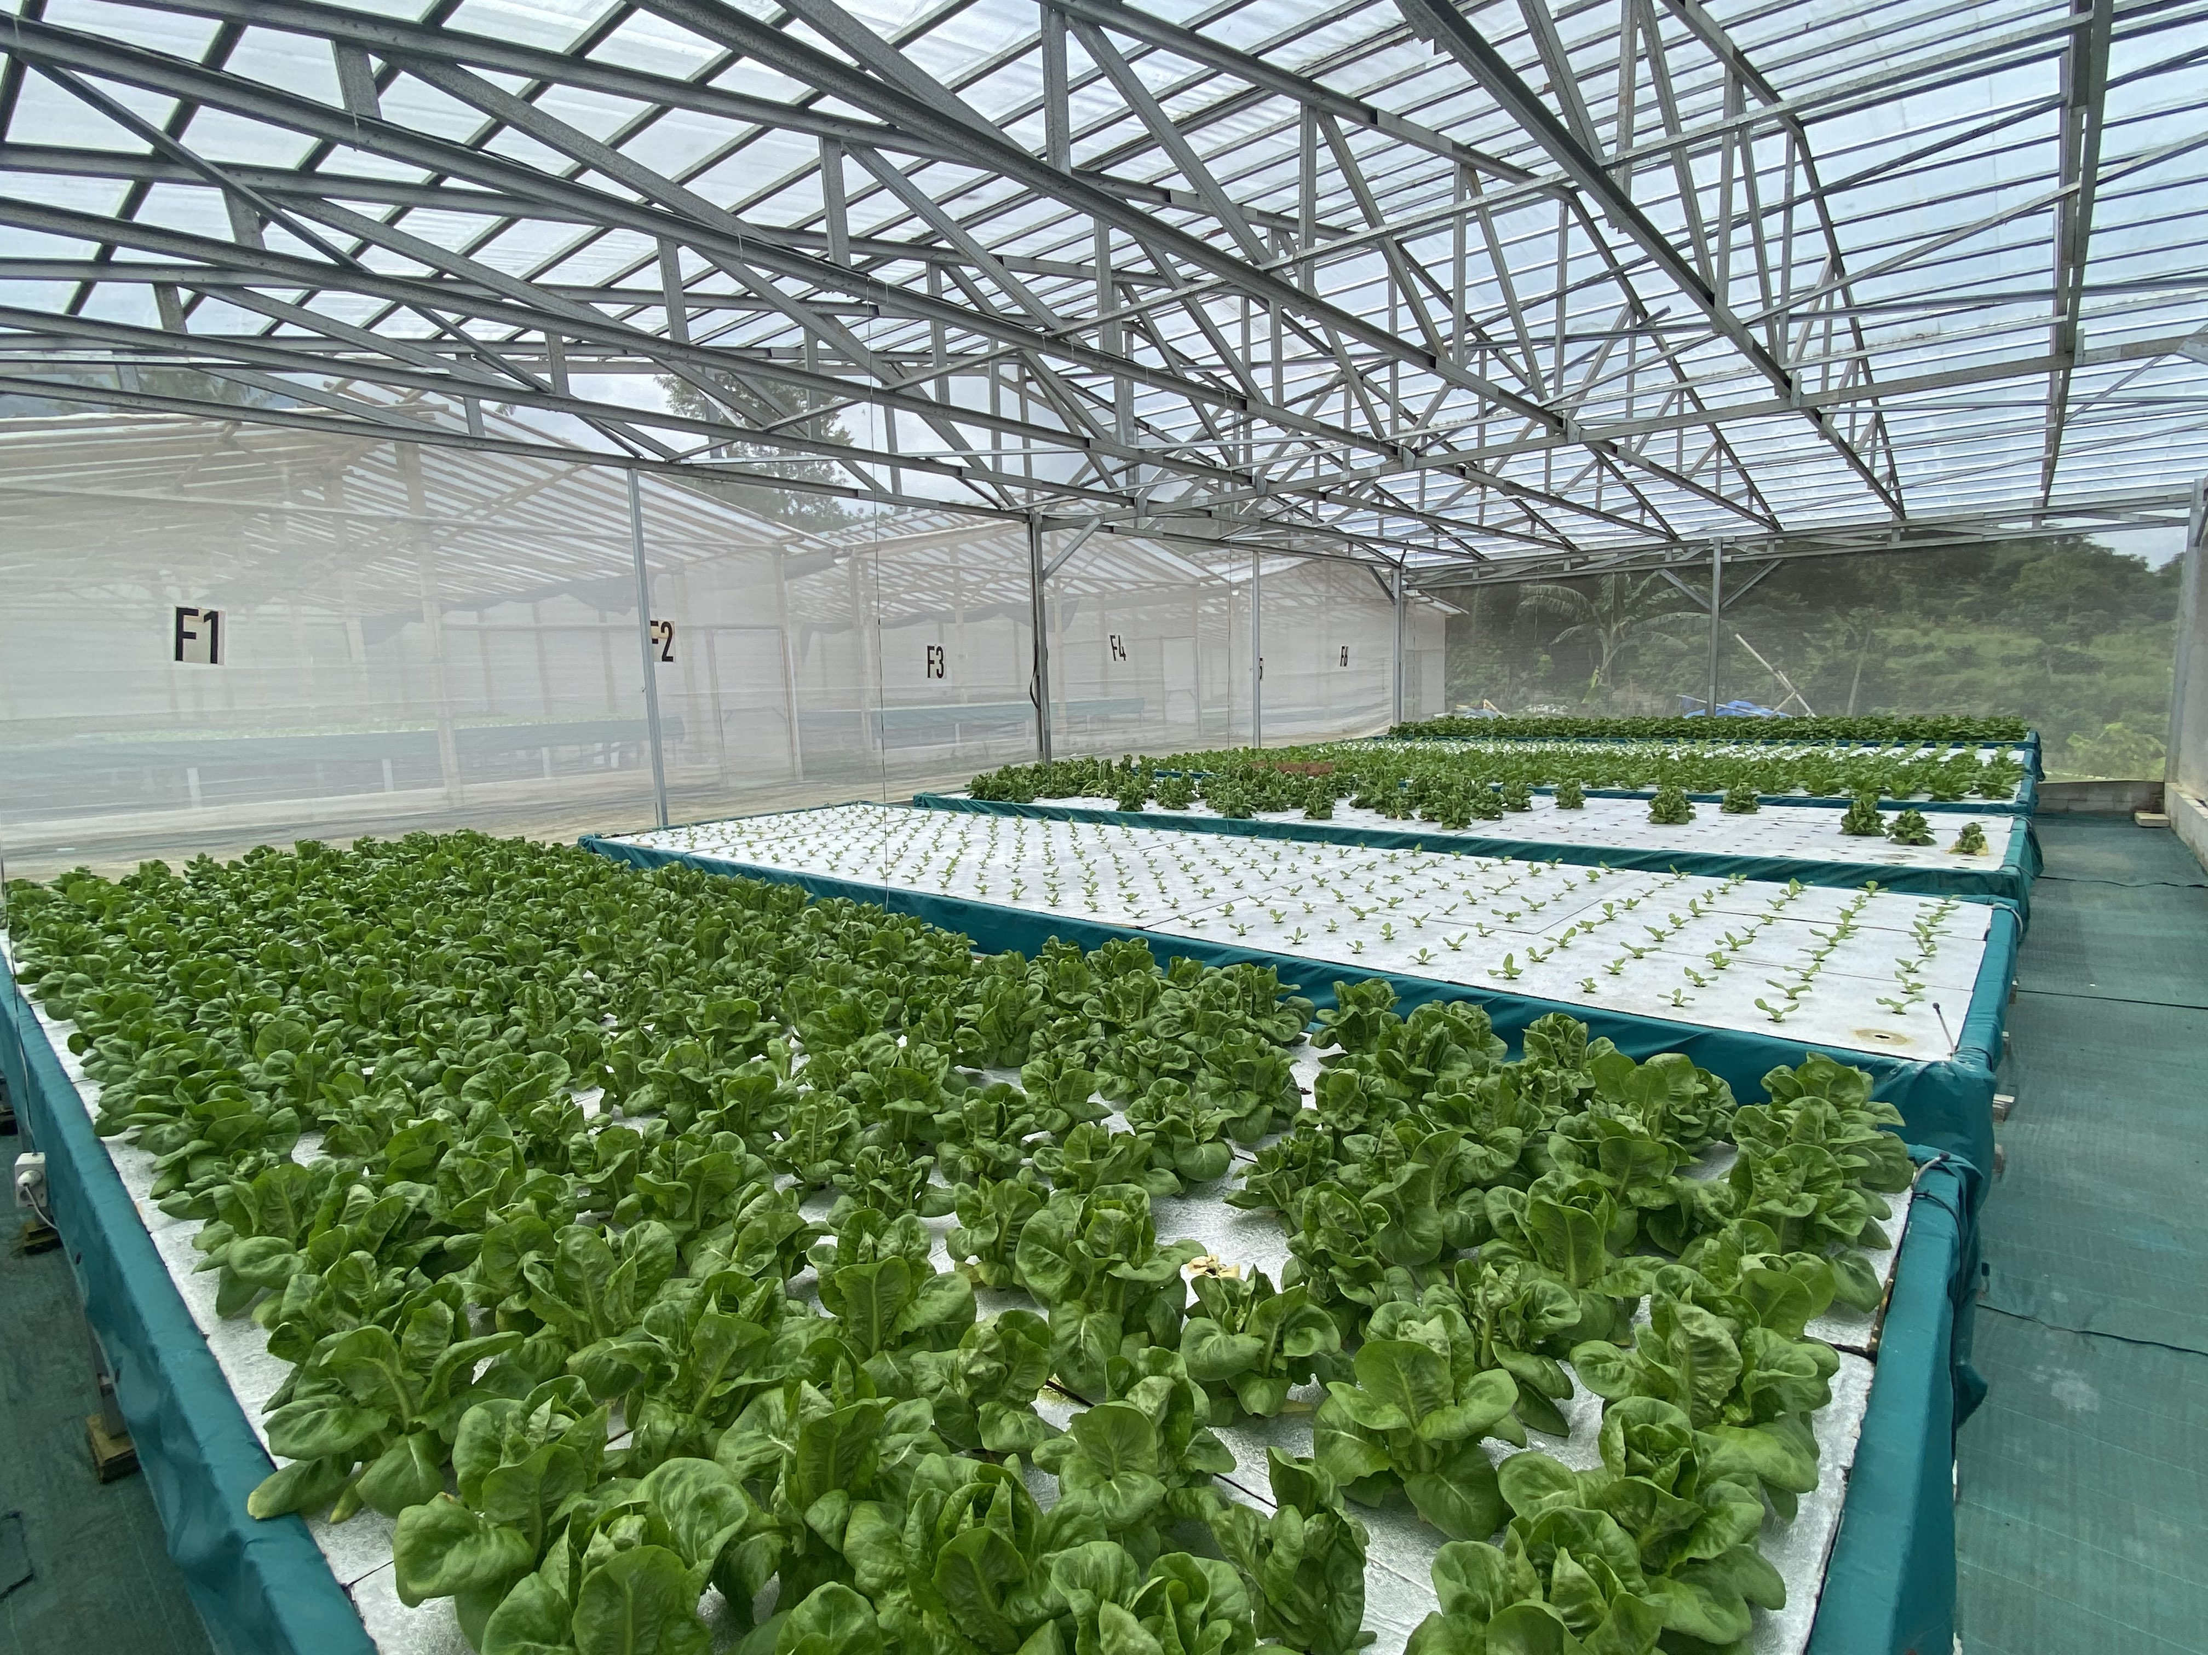

IOT ENABLED HYDROPONIC FARM MONITORING
THESIS FINAL DEFENSE
FRIDAY, 15 DECEMBER 2023
JASON ALEXANDER 2440042310
Notes:
Good morning everyone… Good morning sir…
Before we start, I’d like to thank you all for sparing some time in your undoubtedly busy morning and…, well…, afternoon. So, let’s get straight to it.
Today I’ll be presenting my thesis defense presentation, titled “I.O.T Enabled Hydroponic Farm Monitoring”.
If you have any questions, please feel free to interrupt me and ask for clarification.

Slide 2
Table of Contents
General Summary of the chapters on this presentation.
01
02
03
04
05
Introduction
Solution Design
Solution Implementation
Evaluation & Discussion
Conclusion
Background
Problem Analysis
Objectives
Technology
Design
Limitations
Arduino
Database
API
Web Application
Evaluation
Discussion
Conclusion
Recommendation
Notes:
Right, so this is table of contents. You might remember some of these items from the pre-defense presentation back in April.
There are 5 chapters.
- Beginning with Introduction, we will talk about the background, the problem analysis, and the case study objectives..
- In the second chapter of Solution Design, we will talk about the technology used in this case study, the solution design, and its limitations.
- Starting from the third chapter, Solution Implementation, are new materials that were not covered during the pre-defense. These are the implementations for the Arduino, Database, API, and Web Application.
- In the fourth chapter, Evaluation & Discussion, we will evaluate the case study results and discuss the results of that evaluation.
- Finally, in the fifth chapter, Conclusion, we will make a conclusion and a recommendation statement.
Because our time is limited, I’ll be skimming over chapters 1 and 2 rather quickly because I’ve already presented most of the materials in these two chapters back during the pre-defense.
Let’s get to it.

Slide 3

Introduction
01
Background | Analysis | Objectives
Notes:
Starting with introduction….
We will be covering background, problem analysis, and the case study objectives.

Slide 4
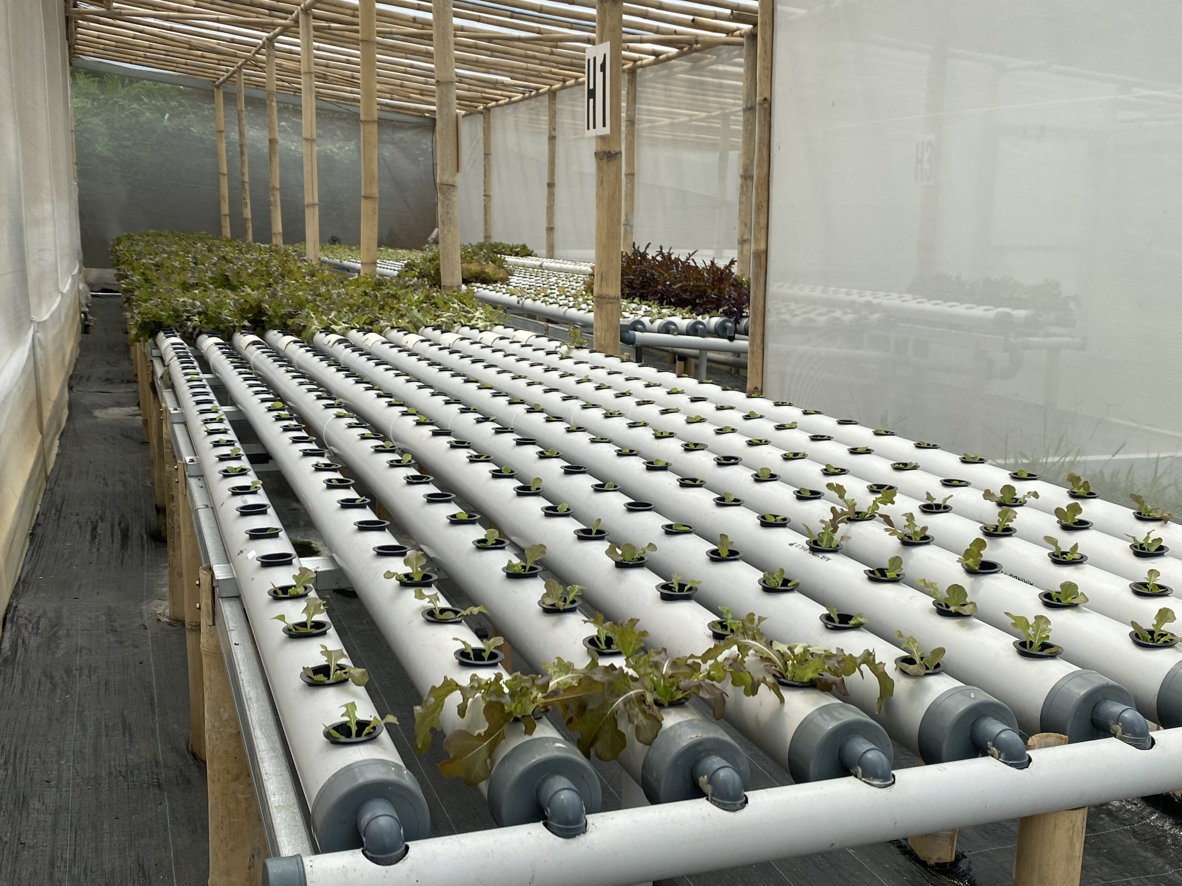
Background
Company Profile, Just Hydroponics
Just Hydroponics is a family-owned company located in the outskirts of Bogor.
They are a medium-sized farm with around a dozen hydroponic greenhouses with plans for expansion soon.
They employ a small number of mostly local blue-collar staff with little to no educational background.
Notes:
This is the profile of the company which I used as an object of study. Just Hydroponics.
- 1st Para –
- 2nd Para –
The image on the right here is one of their “Greenhouses”, you can see the hydroponic plantations here.
- 3rd Para –

Slide 5
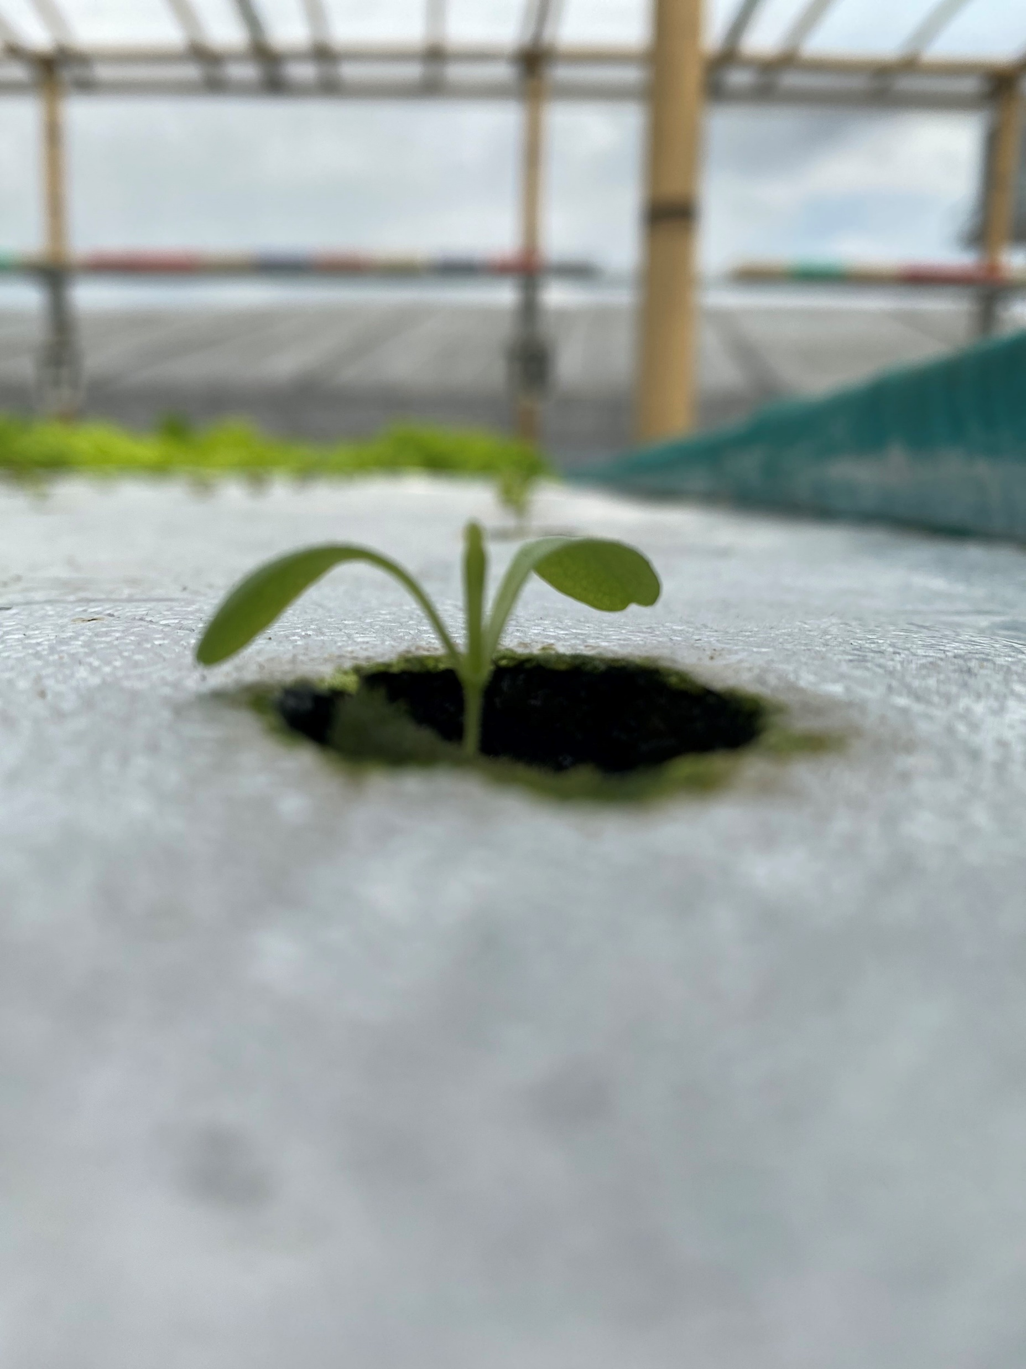
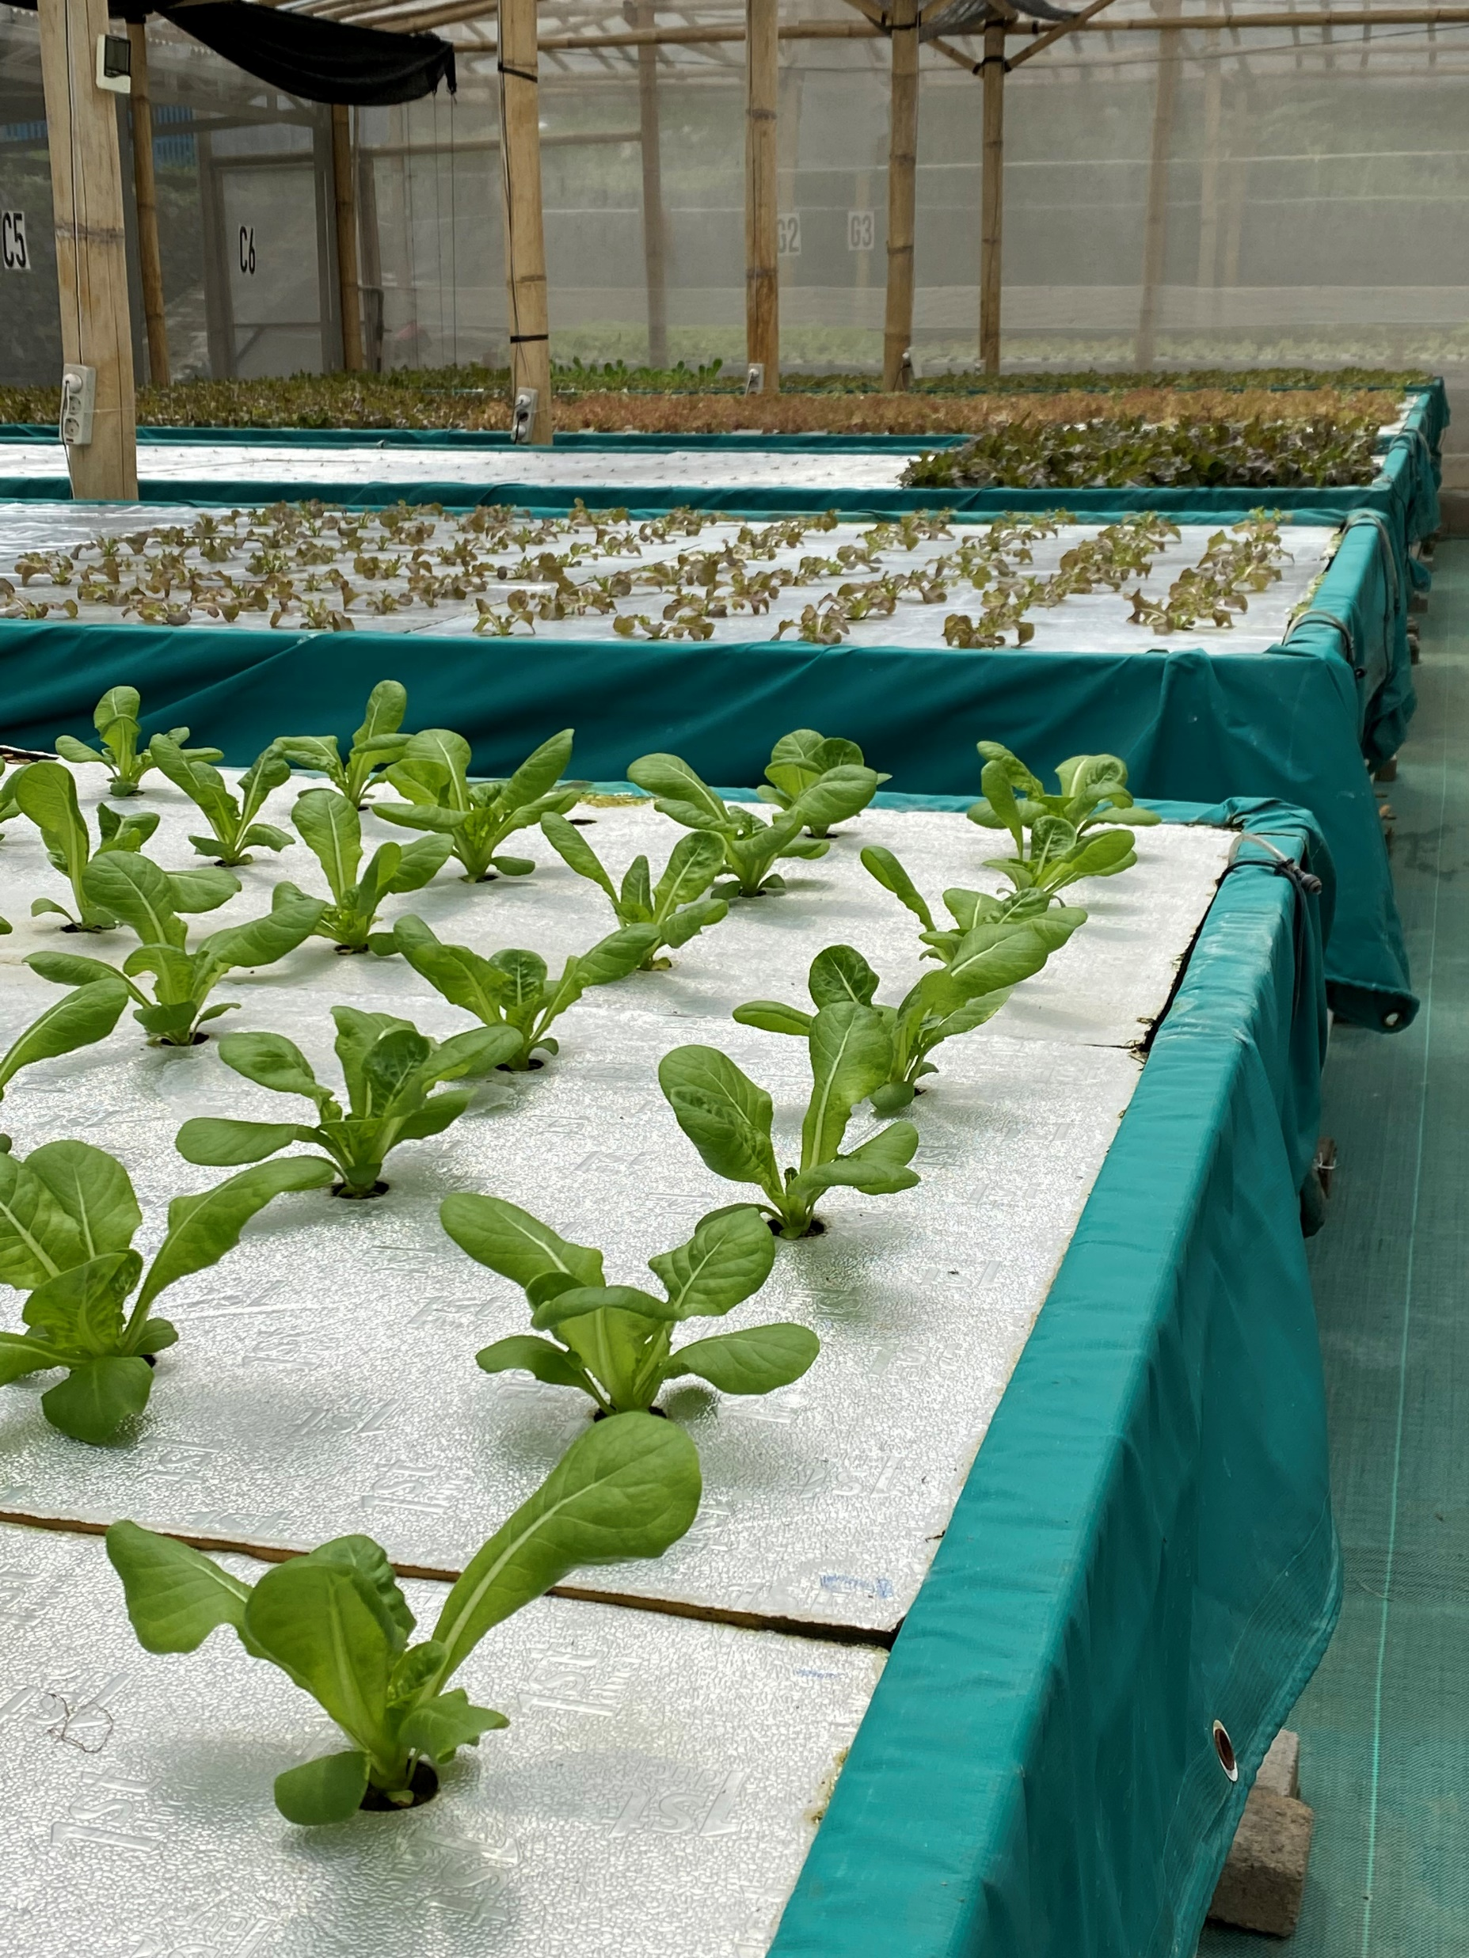
Background
Company Profile, Just Hydroponics
Notes:
These are some more pictures of their other greenhouses to give you an image of what they look like.
I took these images myself on my visits there.

Slide 6
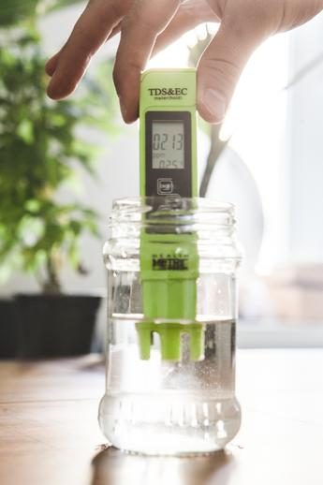
Analysis
Current Method of Data Collection
Just Hydroponics currently collects only nutrient data. The collection is done manually using hand-held tools. They have a few of them with different brands/manufacturers.
(+) Practical, pragmatic, simple, and easy to use.
(-) Low scalability.
(-) Laborious and Inefficient.
(-) Slow reaction time (measured once per day).
(-) Inconsistent Data
Notes:
Moving on to the problem analysis…
Beginning with their method of data collection…
- Read paragraph –
These are illustrated on the image on the right.
Of course their current method also has its upsides, but with major downsides…
- Read pros & cons –

Slide 7
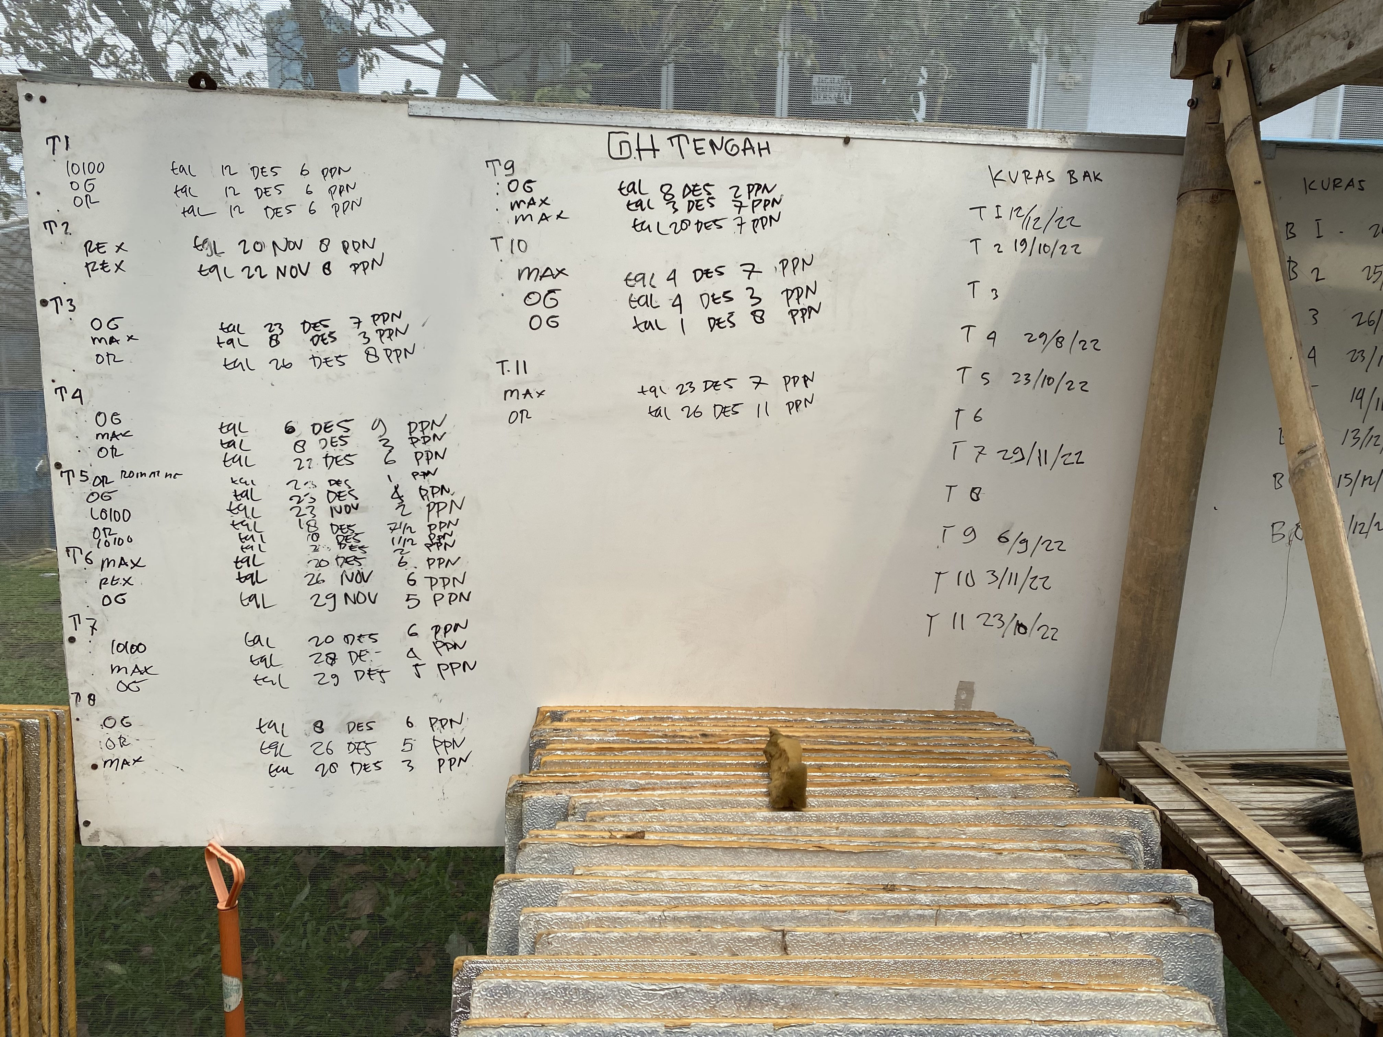
Analysis
Current Method of Data Storage
Just Hydroponics currently stores their collected nutrient data on whiteboards.
There are whiteboards on each greenhouse.
(+) Practical, pragmatic, simple, and easy to use.
(-) Low data capacity.
(-) Very low data integrity. Impossible to recover if accidentally wiped.
(-) Subject to human error.
Notes:
And then there is their method of data storage…
- Read Paragraph –
- Read pros & cons –

Slide 8
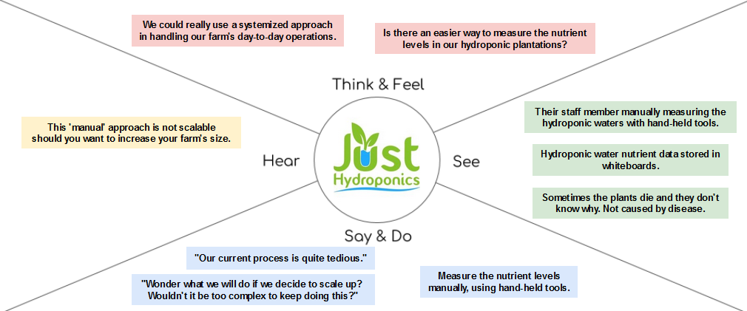
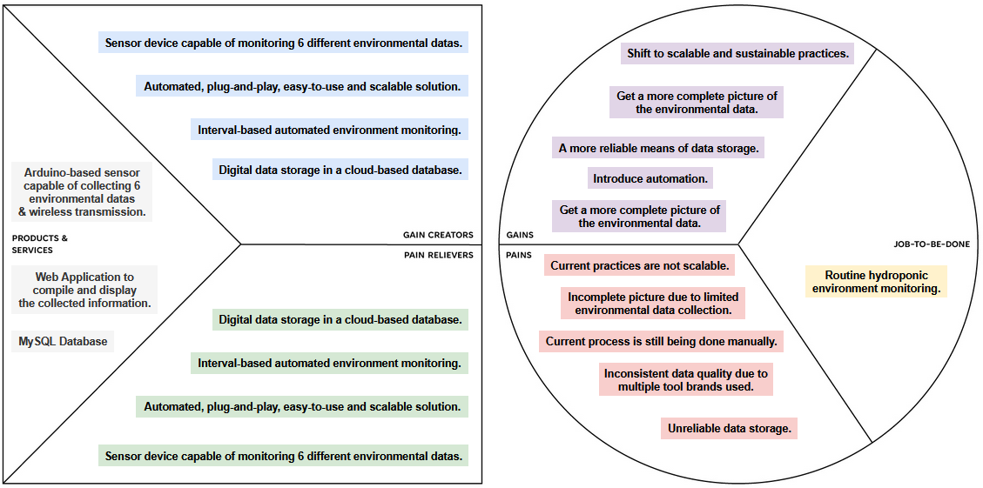
Analysis
Understanding The “Client”
After understanding what the client’s profile, I used a Value Proposition Canvas to summarize and solidify the product/service that my solution needed to provide.
Value Proposition Canvas
Empathy Map
To gain a better understanding of the client and know what they want, I used an Empathy Map.
Notes:
So, in order to understand the, in quotation marks, client, Just Hydroponics, I used an empathy map and a value proposition canvas.
- Read Empathy-Map para –
- Read VPC para -

Slide 9
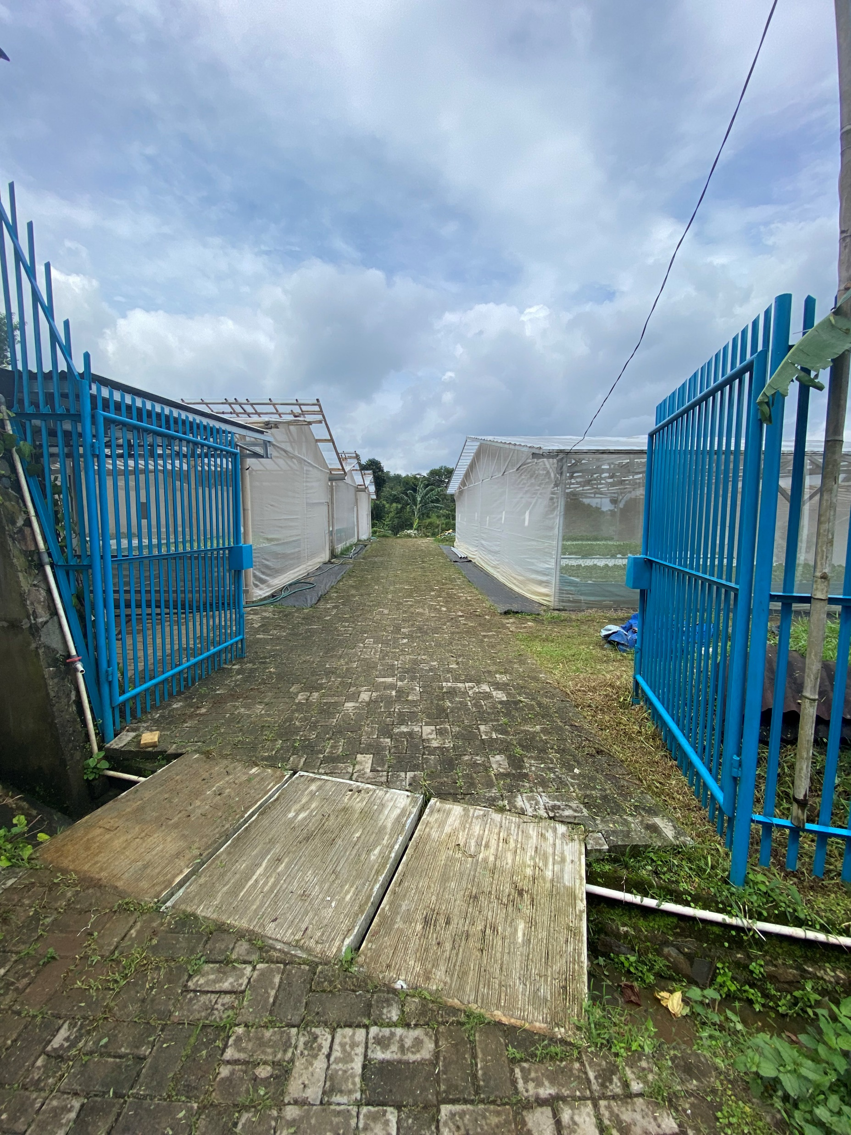
Analysis
Conclusion
In short: Lack of scalability.
Just Hydroponics has expressed interest in further expansion, but a brief analysis of their processes reveals potential problems, which haven’t surfaced yet because their operations are still relatively small.
An expansion would expose these problems and cause issues for Just Hydroponics.
A solution needs to be devised. That solution needs to solve the problems which we have just discussed.
I decided on an Arduino-based sensor device, which transmits environmental sensor data to a web application, where it would be readily available on demand and constantly and automatically updated.
Notes:
In conclusion, their primary issue is a lack of scalability.
To elaborate further on that…
Just hydroponics wants to expand, but my analysis results show that because they lack scalability, expansion would cause numerous problems.
So to solve these problems, I devised a solution.
An Arduino based sensor device, which transmits data to a web application, where it would always be available when needed by the user.

Slide 10
Objectives
Case Study Objective
The creation of a systemized hydroponic farm monitoring solution with:
A physical Arduino-based sensor.
A web application powered by PHP.
A database for data storage.
The Solution’s primary purpose is to serve as a proof-of-concept and technical demonstrator.
Due to constraints in time and resources, the resulting solution will likely not be commercially viable, yet.
Notes:
So, before I started working on the solution itself, I made a list of case study objectives.

Slide 11
Solution Design
02
Technology | Design | Limitations
Notes:
Moving on to the solution design.
We will be covering…

Slide 12
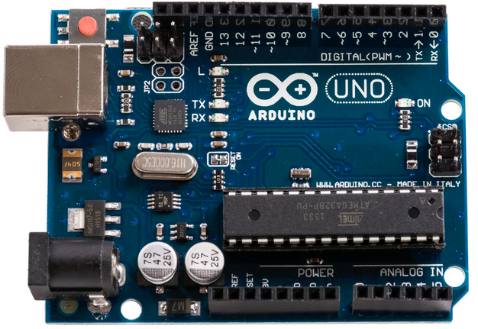
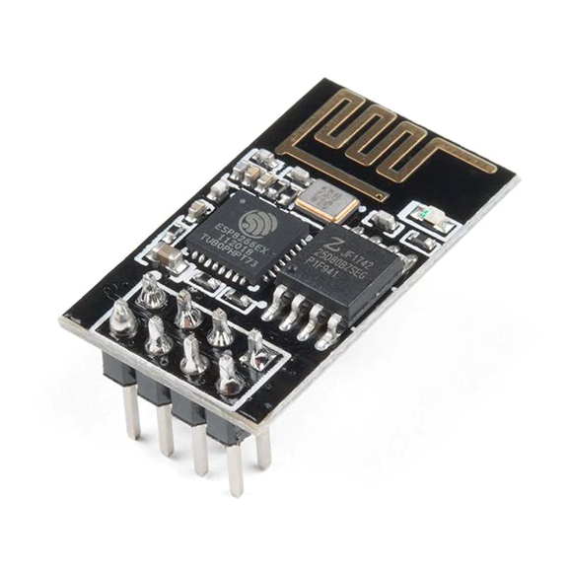
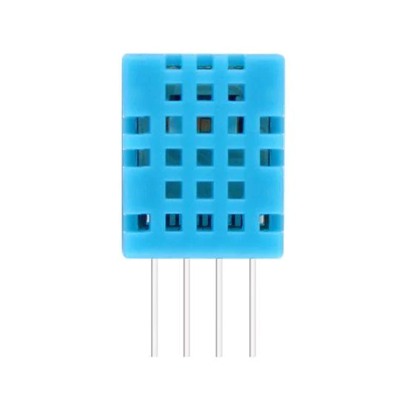
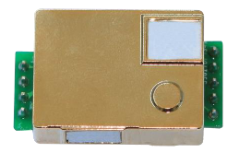
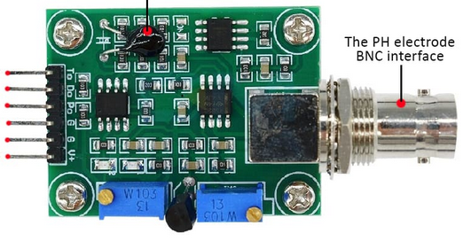
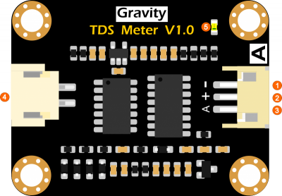
Technology
Arduino - Hydroponic Sensor
Arduino Uno R3 Motherboard
ESP-01 Wi-Fi
DHT11 Air Temperature & Humidity
MH-Z19B CO₂
PH-4502C CO₂
TDS Meter Nutrient Levels
Notes:
Starting with technology.
These are the technologies which will be used for the hydroponic sensor device.

Slide 13





Technology
Website, Database & API
Notes:
And then these are the technologies that will be used for the web application, database, and API.

Slide 14
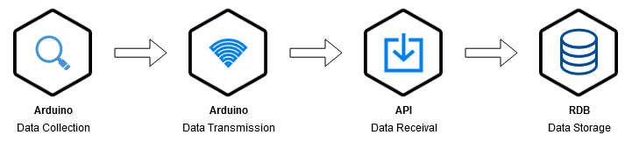
Design
Process Cycle
Notes:
Moving on to DESIGN.
This is the process cycle for the entire system.
Beginning with …

Slide 15
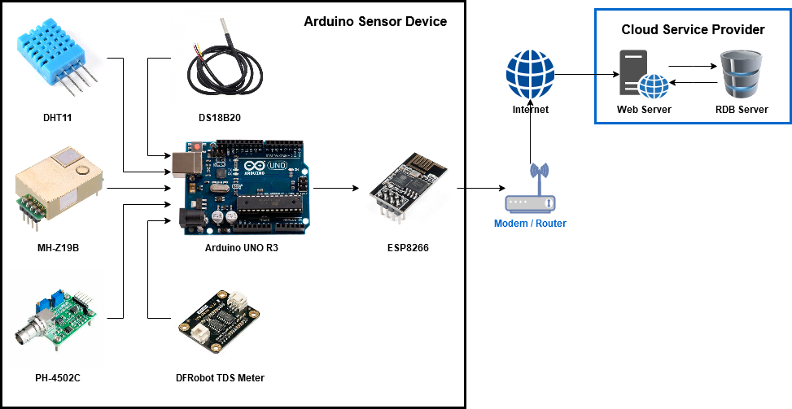
Design
Hydroponic Sensor Schematic
Notes:
So this is the high-level conceptual sensor design…

Slide 16
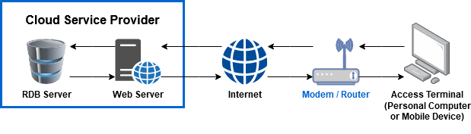
Design
Web Application & Database Architecture
Notes:
And this is the high-level conceptual design for how a user’s interaction with the web application will look like.

Slide 17
Design
Web Application, API Format
The String above illustrates how the sensor data will be transmitted into the API.
Because the web application and the API uses PHP, the data String is formatted to be compliant with PHP’s $_GET superglobal variables.
Notes:
This is a concept of how data from the Arduino device will be transmitted to the web server.
- Read … -

Slide 18
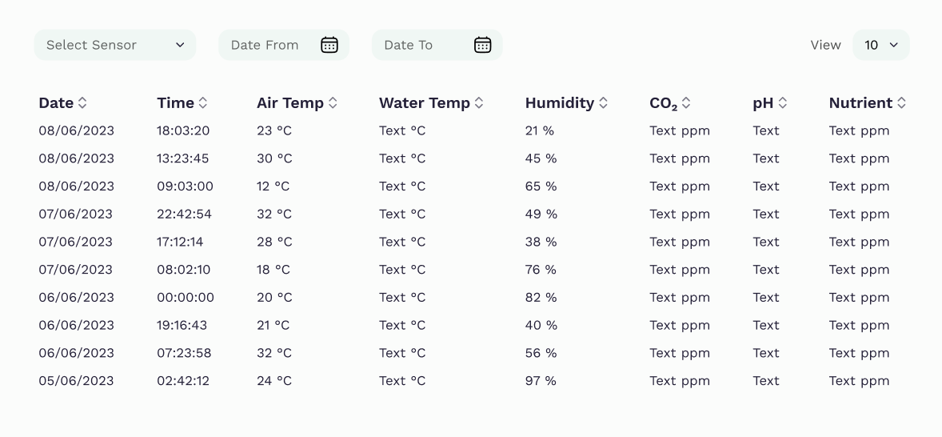
Design
Web Application, Early UI Design
Notes:
This is the early “optimistic” design for the user interface.
I say optimistic because in the field of Information Systems, I specialize primarily in the systematic process.
I know how to make the systems and how to chain them all together, but I am completely lacking when it comes to UI/UX design.
I lack the necessarily skills to make things look this “beautiful”, so don’t expect the actual result (which will be covered in chapter 4) to look this good.

Slide 19
Limitations
Scope, Arduino
The sensor device will be limited to monitoring. No capability to actively ‘influence’ the hydroponic farm.
Six environmental variables: water temperature, air temperature, humidity, CO₂ levels, pH levels, and nutrient density.
The device should be able to operate wirelessly with only a power source and an access to Wi-Fi.
The device will be only an early prototype. It will not have a casing design yet.
Notes:
Next point is limitations.
Before we start, I should say that I declared limitations because I don’t have superpowers.
I only have so much in the way of time, resources, manpower, and skill.
Don’t get me wrong, I’d like to make this case study even more expansive than it is,
But taking into account that:
I had to do this in parallel with a full-time internship
There is quite literally only one person (which is me) working on this
I lack the necessary diversity in skills to bring this project to total completion, and have to limit it to a proof of concept.
Back to the limitations…
- Read points -

Slide 20
Limitations
Scope, Web Application
The user-facing side: a prototype with limited capabilities.
Can display data from a user selected criteria / filter.
No ability to modify data.
A database will be used to store the data collected by the Arduino device.
The website will have an “API” feature that acts as a middleman to receive data from the Arduino and store it into the database.
It will be developed using base PHP 8.
Notes:
And as for the limitations of the web application:
- Read points -

Slide 21
Solution Implementation
03
Arduino | Database | API | Web Application | Test Plan
Notes:
On to the third chapter, Solution Implementation.
We will cover …

Slide 22
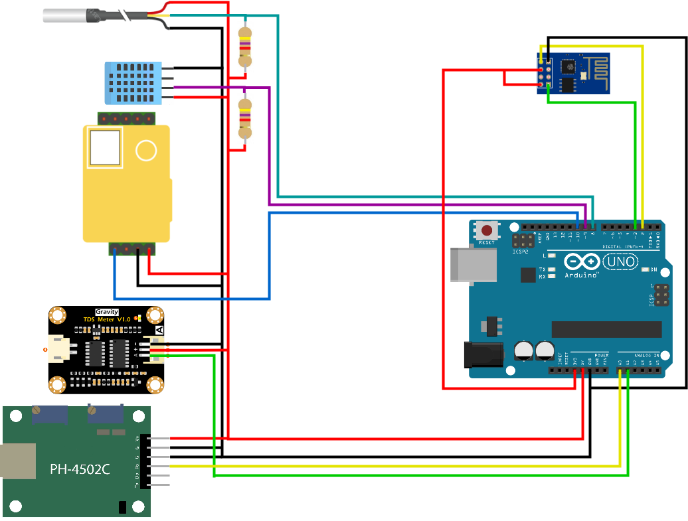
Arduino
Hydroponic Sensor
This is a schematic of the sensor prototype.
Notes:
- No notes -

Slide 23
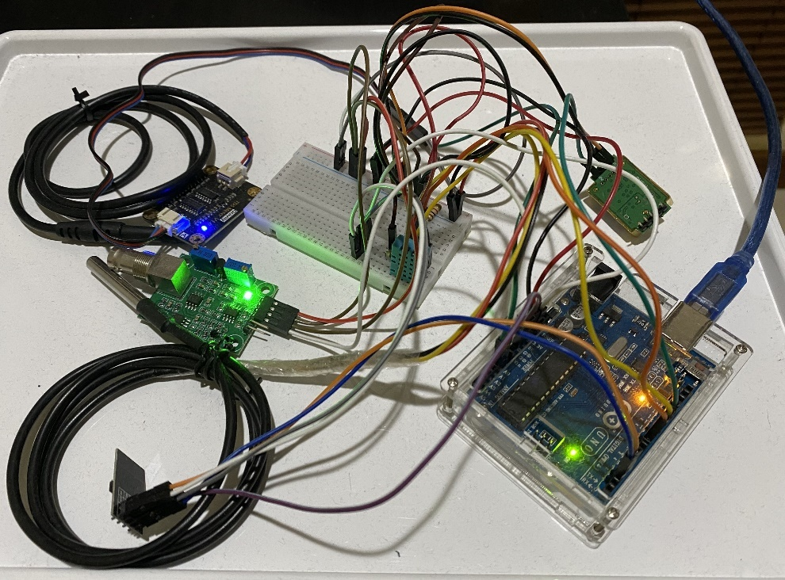
Arduino
Hydroponic Sensor
This is the sensor prototype, the first of two.
Notes:
- No notes -

Slide 24
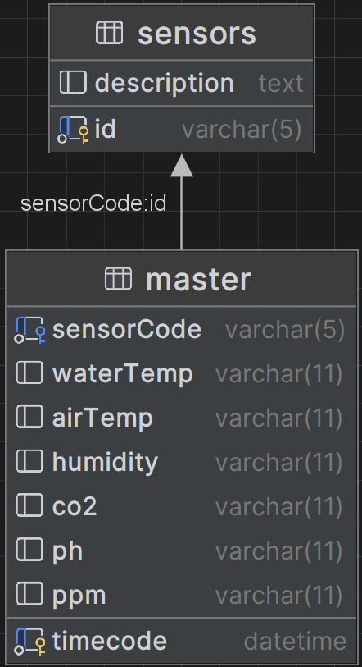
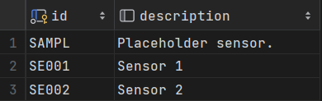
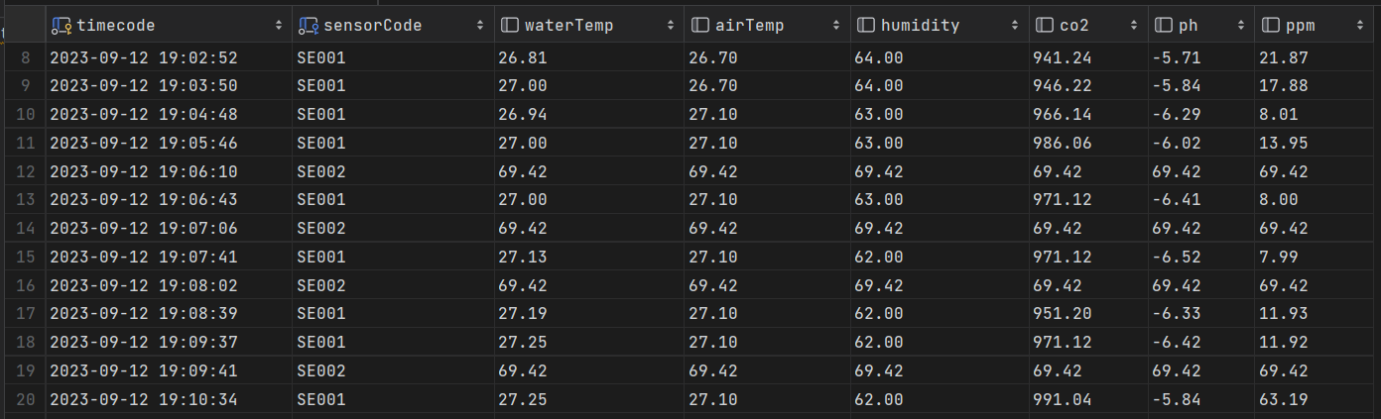
Web Application
Database Implementation
Two tables, containing sensor information and the master data.
Six master variables on the master table.
Notes:
- No notes -

Slide 25
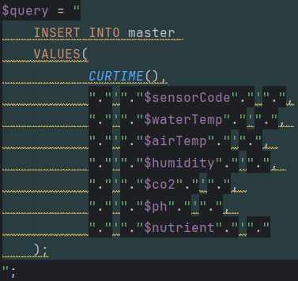
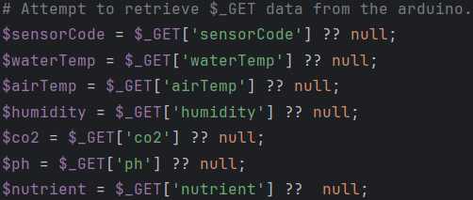
Web Application
API Implementation
3
1
2

Slide 26
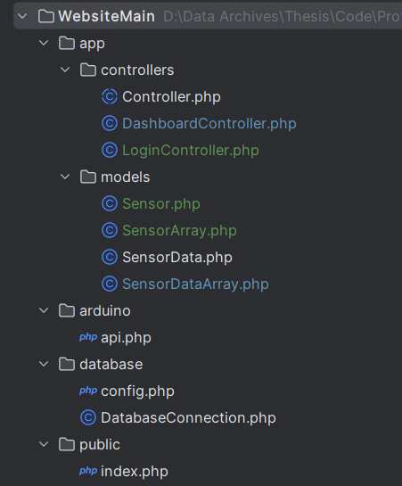
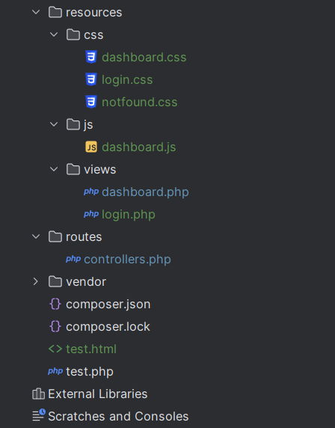
Web Application
Web Application, Structure
Notes:
- No notes -

Slide 27
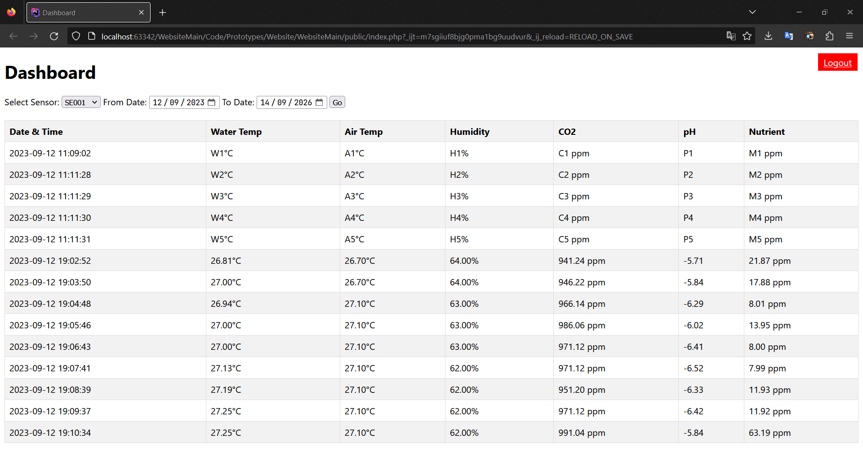
Web Application
Web Application, Dashboard
Notes:
- No notes -

Slide 28
http://13.212.254.69/public

Slide 29
Evaluation & Discussion
04
Evaluation | Discussion
Notes:
Moving on to the fourth chapter, Evaluation & Discussion.
We will cover …

Slide 30
Evaluation
Test Plan
Unit Test Tests each individual module. See if each module works as specified.
Integration Test Tests inter-module synergy. See if each module works as expected when operated as a part of a larger system.
End-to-End Test Simulates actual use, system is tested from start to end of the process cycle. Further divided into: Basic Acceptance Test, Reliability Test, and Multi-Device Test.
Notes:
- read all –
For details on everything, its too long to be put here, read the report.

Slide 31
Evaluation
Unit Test
ESP-01 Wi-Fi
DHT11 Air Temperature & Humidity
MH-Z19B CO₂
PH-4502C CO₂
TDS Meter Nutrient Levels
Notes:
In a unit test, each and every single one of these components are tested to see if they perform as expected.

Slide 32
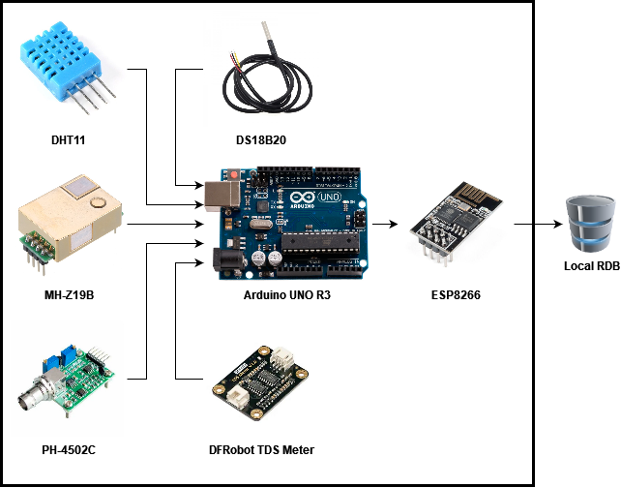
Evaluation
Integration Test

Slide 33
Evaluation
End-to-End Test
Notes:
Again, end-to-end simulates actual use, and there is no better way of testing that other than actually using it

Slide 34
Evaluation
Test Results Summary
Unit Test
Arduino (PASS)
Web Application (PASS)
Integration Test
Arduino (PASS)
Web Application (PASS)
End-to-End Test
Basic Acceptance Test (PASS)
Reliability Test (Requires Attention)
Multi-Device Test (PASS)
Notes:
These are a short summary of the test results.
- Read the headers -
Most of these tests are yes/no questions of whether the test subject is working as intended or not, they’re pretty boring.
Due to time constraints and because they all passed I’ll be skipping most of these results.
However, there is one test result that you might be interested in, and that is the reliability test results.
Oh and you might also be wondering what is a multi-device test

Slide 35
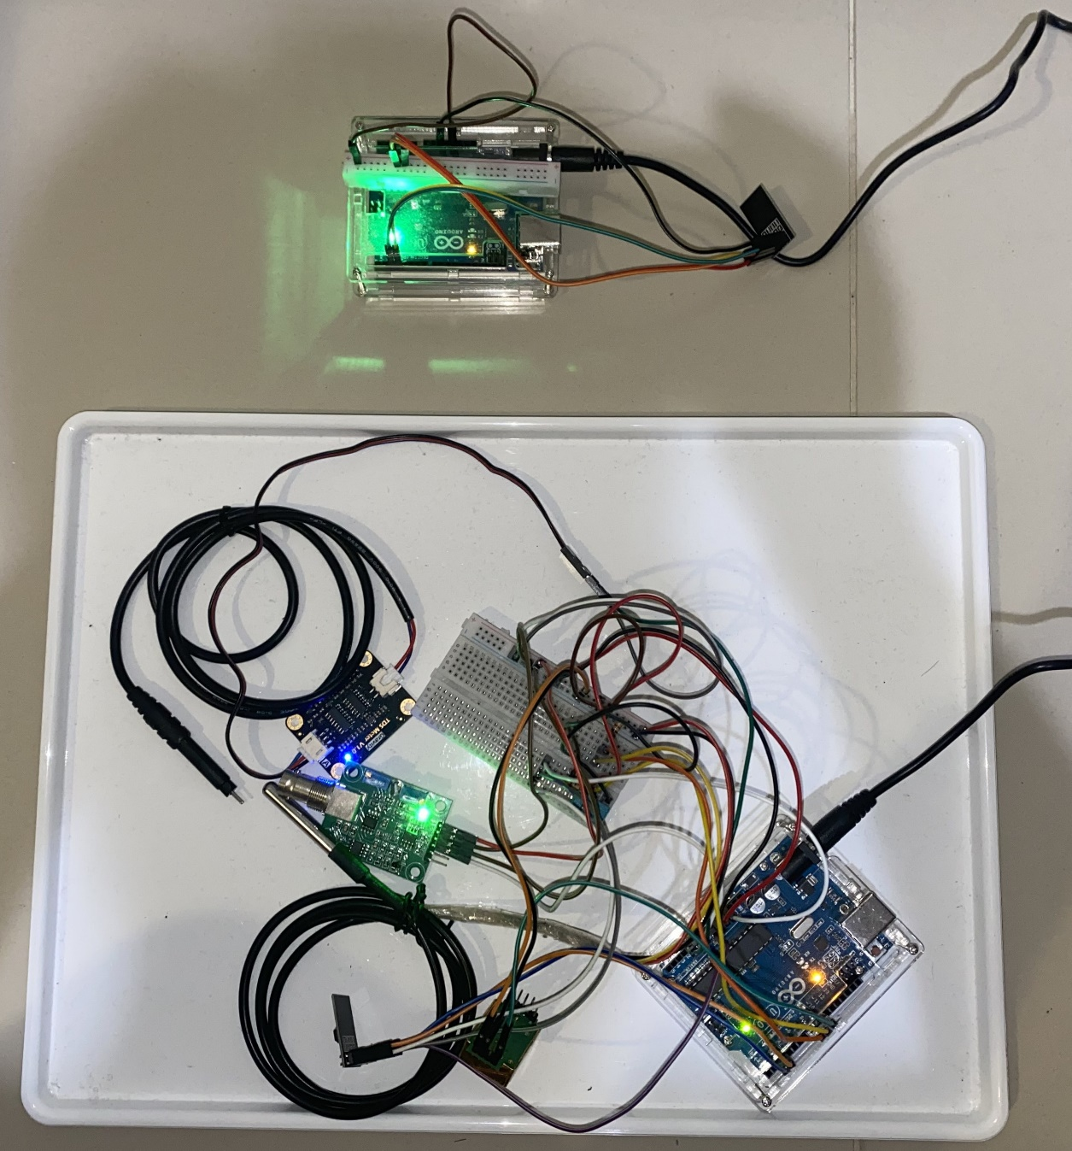
Evaluation
Multi-Device Test

Slide 36
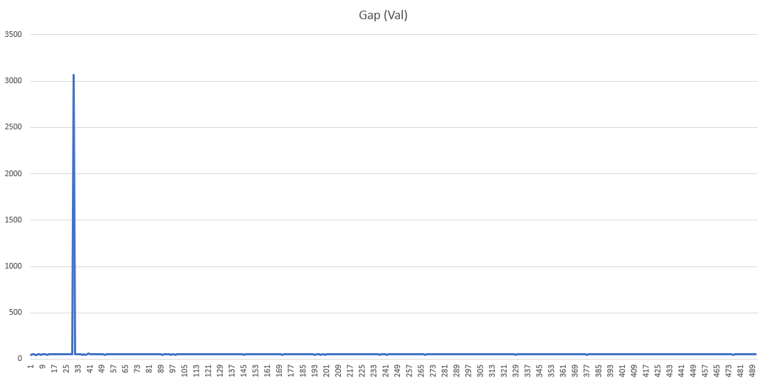
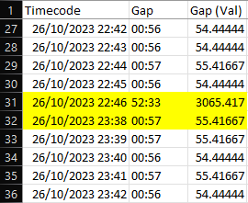
Evaluation
Reliability Test, 8-hour Local Test
Reliability ~89.13%
Notes:
The reliability testing was performed from 26/10/2023 10:19:46 PM until 27/10/2023 6:45:21 AM, which amounted to 8 hours, 25 minutes, and 35 seconds. In this timeframe, there was 492 successful insertion cycles with only a single anomaly between the 30th and 31st insertions. Under normal operating conditions, the gap between insertions is around ~56 seconds, but in the anomaly, the delay between insertions was 52 minutes and 33 seconds. Within that gap there should have been ~60 insertion cycles.
The overall reliability rating can be calculated by dividing what is by what should have, which means that the reliability is ~ 492 / (492+60), which amounts to ~89.13%.

Slide 37
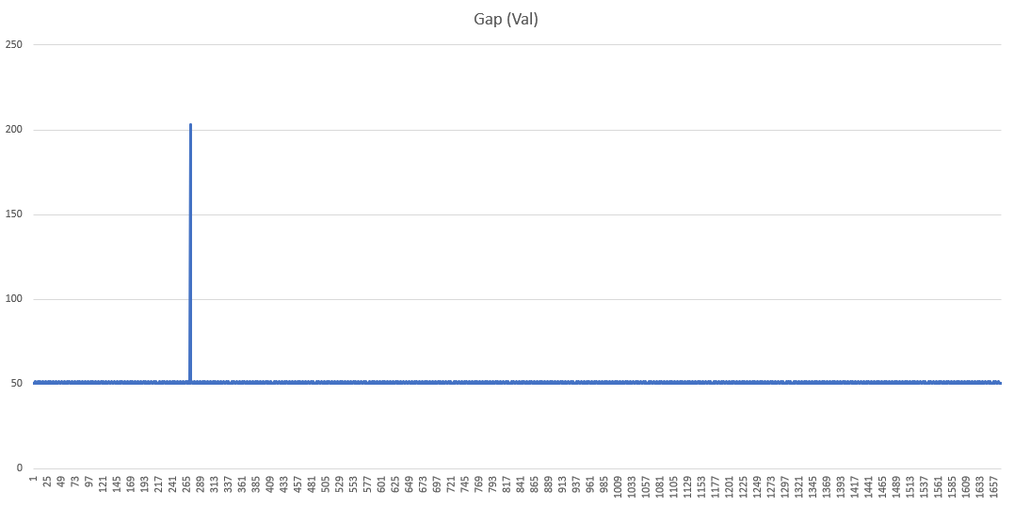
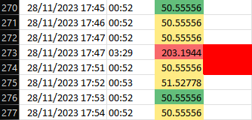
Evaluation
Reliability Test, 24-hour Cloud-based Test
Reliability ~99.76%
Notes:
The cloud reliability testing was performed from 28/11/2023 13:52:04 PM UTC until 29/11/2023 14:07:18 PM UTC, which amounted to 24 hours, 15 minutes, and 14 seconds. In this timeframe, there was 1670 successful insertion cycles with only a single anomaly between the 272nd and 273rd insertions. Under normal operating conditions, the gap between insertions is around ~52-53 seconds, but in the anomaly, the delay between insertions was 3 minutes and 29 seconds. Within that gap there should have been ~4 insertion cycles.
The overall reliability rating can be calculated by dividing what is by what should have, which means that the reliability is ~ 1670 / (1670+4), which amounts to ~99.76%.

Slide 38
Discussion
Not Ready for Commercialization The current prototype is extremely unfriendly to end users.
It requires knowledge on how to modify Arduino programming, database management, and server troubleshooting.
Wi-Fi Reliability The current prototype depends heavily on the stability of the Wi-Fi connection that it is connected to.
It has no “backups” or any ability to self-troubleshoot should anything go wrong with the Wi-Fi.
Notes:
With the results of our evaluation, there are several points that merits discussion.

Slide 39
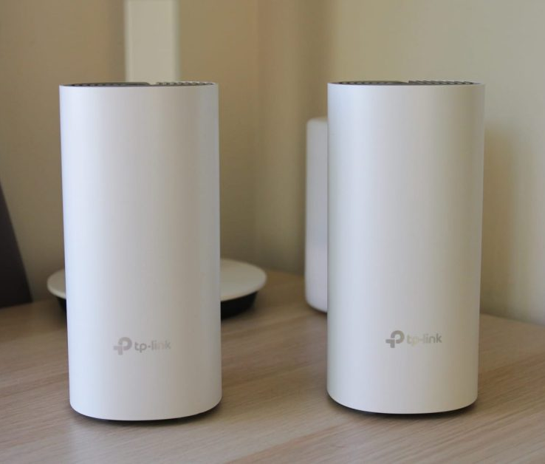
Discussion
Range Extension
Dr. Michael expressed interest in expanding the device’s range by having them communicate with one another.
This approach is not possible due to the Arduino Uno’s limitations. It can’t provide enough power on 3.3V and its memory can’t bear the increased code complexity.
Utilizing a commercial solution to extend the Wi-Fi network’s coverage is a more practical solution.

Slide 40
Discussion
Data Collection Frequency
Everything is up to the customer.
Currently a client/customer is only able to decide data collection frequency. But with a little development, they will be able to decide things like periodic data deletions (to conserve space).
UI Design Simplicity
The UI design is very simple.
The UI can be further developed on a client/customer’s request.
I think simplicity is a positive point because the day-to-day users will be low-education blue collar workers.

Slide 41
Conclusion
05
Conclusion | Recommendation

Slide 42
Conclusion
Conclusion & Recommendation
Conclusion
Recommendation
Current method of data collection is manual, infrequent, and lack standards.
Use of whiteboards to store data compromises data integrity.
Current processes are laborious, inefficient, time-consuming, prone to errors, and are not scalable.
An automated system based on Arduino, PHP, and MySQL was created to address these problems.
This case study successfully produced a working proof-of-concept prototype.
Lacks studies for commercialization due to project constraints.
Casing design study. Needs a casing. Current design is just a prototype of jumper cables.
Independent 3.3V power supply for the ESP-01. Current power supply is insufficient for the ESP-01.
Economic viability study. Such as economies of scale and cheaper module alternatives.
Parallel local and offsite databases. To increase data integrity should one of them suffer failure.
Improvements on UI/UX, possibly a dedicated app for setup. Current processes are not user friendly and requires direct code modification. Something like a mobile app to configure the sensor device would tremendously increase user-friendliness.

Slide 43
THANK YOU

